Slide 1
Stair Climber Wheelchair 3D CAD Files

Slide 2
How to join this Community
We are Using Github & Grabcad for File 3D CAD sharing
our link in Github:
Our link in GRABCAD:

Slide 3
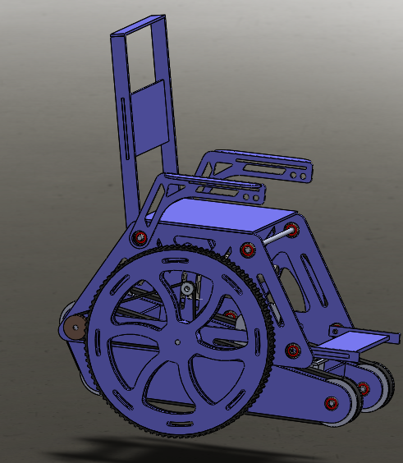
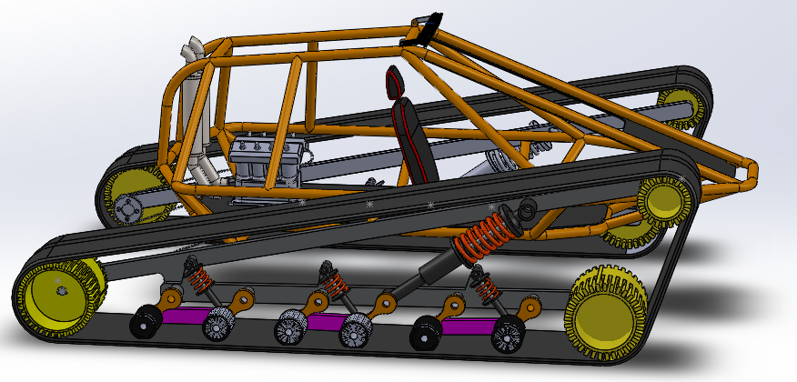
3D CAD References
https://grabcad.com/library/stair-climbing-wheel-chair-3
https://grabcad.com/library/tracked-vehicle-1

Slide 4
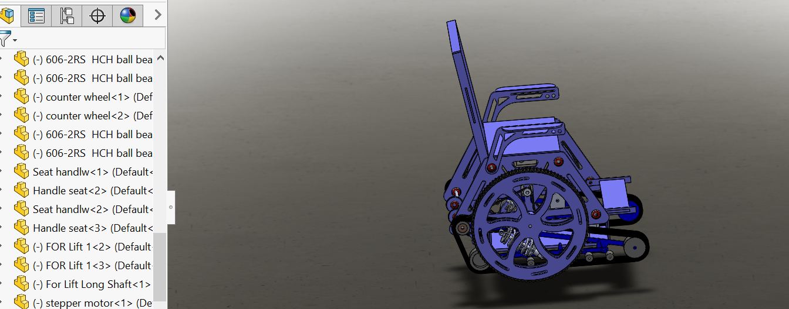
Combining Two 3D CAD Models
For starting we need to combining two Models :

